Slide 1
Capstone Midpoint Presentation
Sirish Desai, Noah Edwards-Thro, Stephanie Landas, Michelle Wu

Slide 2
Does cultural training of teachers improve student outcomes?

Slide 3
Goals
Determine whether teach certification has an effect on student growth.
If there is an effect, is that effect significant?
Determine what other factors may have a stronger effect on student growth.
This project will be used to adjust the Albemarle County Public School teacher trainings over the summer.
Notes:
Unexplored in predictor variables at this time

Slide 4
Data Issues
Missing 4th grade student mathematics information.
Relatively small dataset (<10k cases)
Missing information: some cases do not contain data on growth, reducing the number of cases used in analysis.
FERPA regulations affect analysis.

Slide 5
Issues with Multicollinearity
We noticed that much of our data had an issue with multicollinearity when we wanted to test for an increase in Growth.
Due to this we had to drop the following from our data:
Expected Achievement
Vertical Scaled Score
Actual Achievement Percentile
Value Added Score
In the predictor variables, it is likely that many will show high levels of multicollinearity.
Teacher Years Experience
Teacher Certification
Teacher Education Level
Principal Certification
Notes:
Unexplored in predictor variables at this time

Slide 6
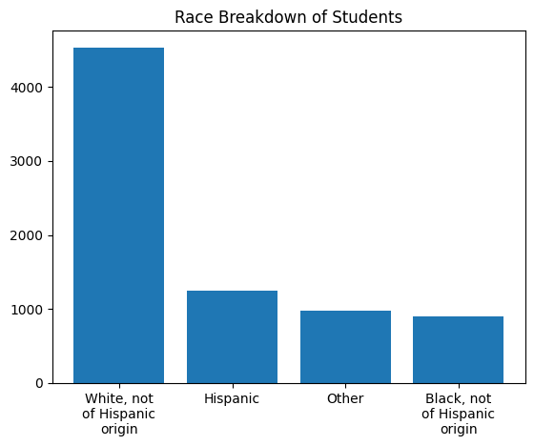
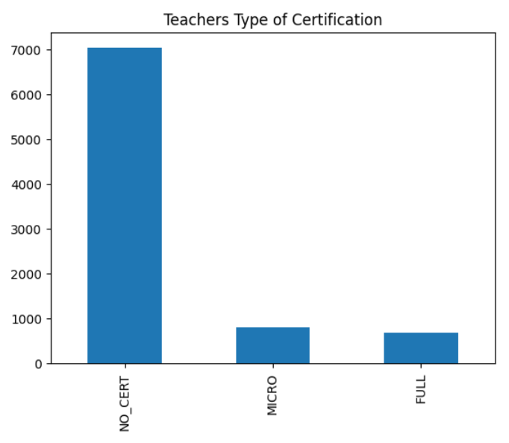
Exploratory Data Analysis

Slide 7
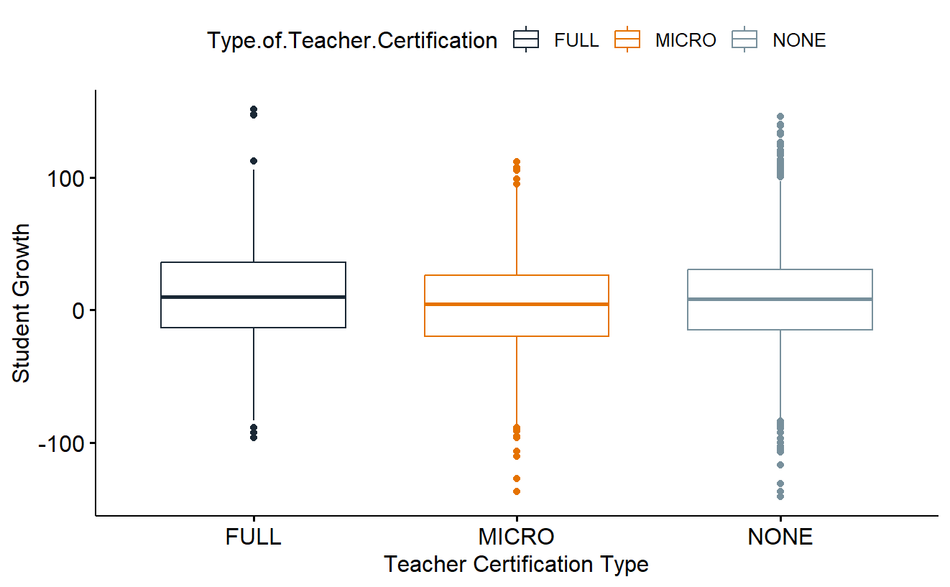
EDA - Teacher Certification & Growth

Slide 8
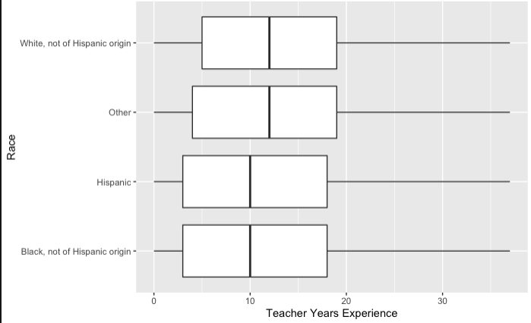
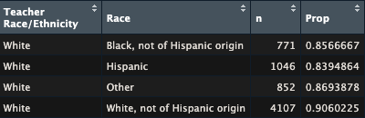
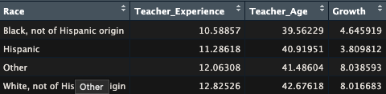
Full Dataset EDA by Race with Teacher
P-Value: 3.4 e-14

Slide 9
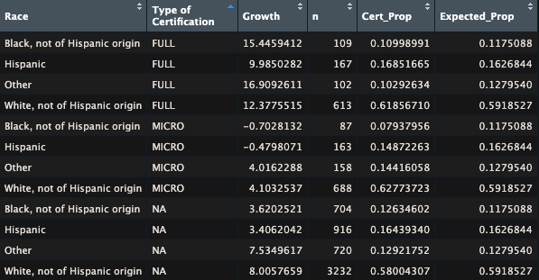
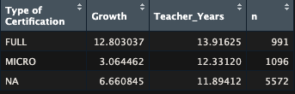
Full Dataset EDA by Certification Type
P-Value: 1.23e-8 for Type of Certification
P-Value: 0.268 for Certified or Not

Slide 10
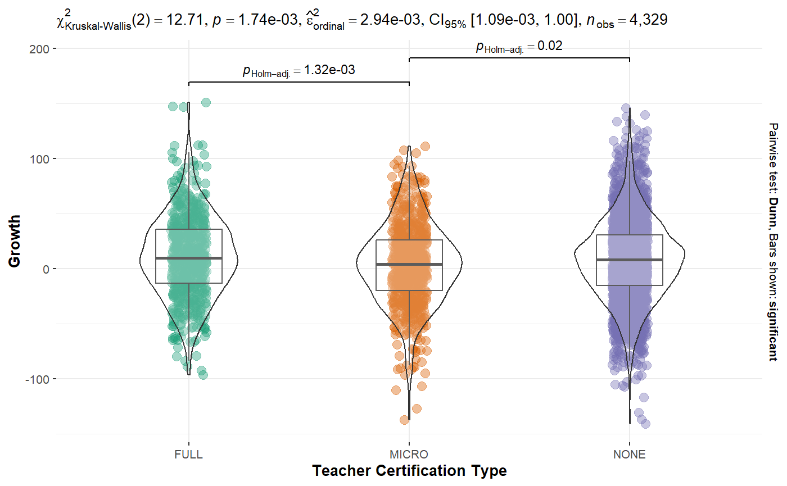
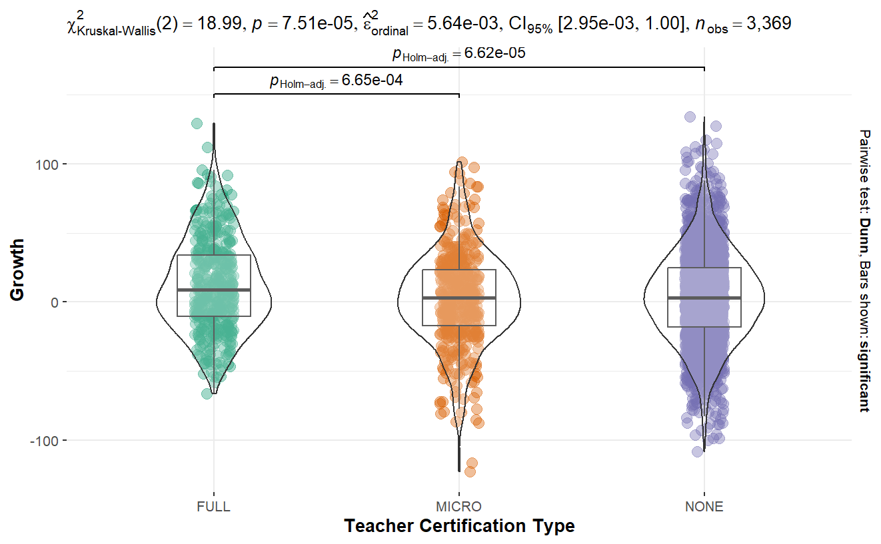
Kruskal-Wallis Test
(Teacher Certification on Growth)
Notes:
ANOVA test didn’t work perfectly, as the normality assumption wasn’t met.
Tests indicate that teacher certification DOES have a significant effect on student growth.
Read dataset (left): There is a significant difference b/w full & micro and micro & none, but not b/w full & none
Math dataset (right): There is a significant difference b/w full & micro and full & none, but not b/w micro & none

Slide 11
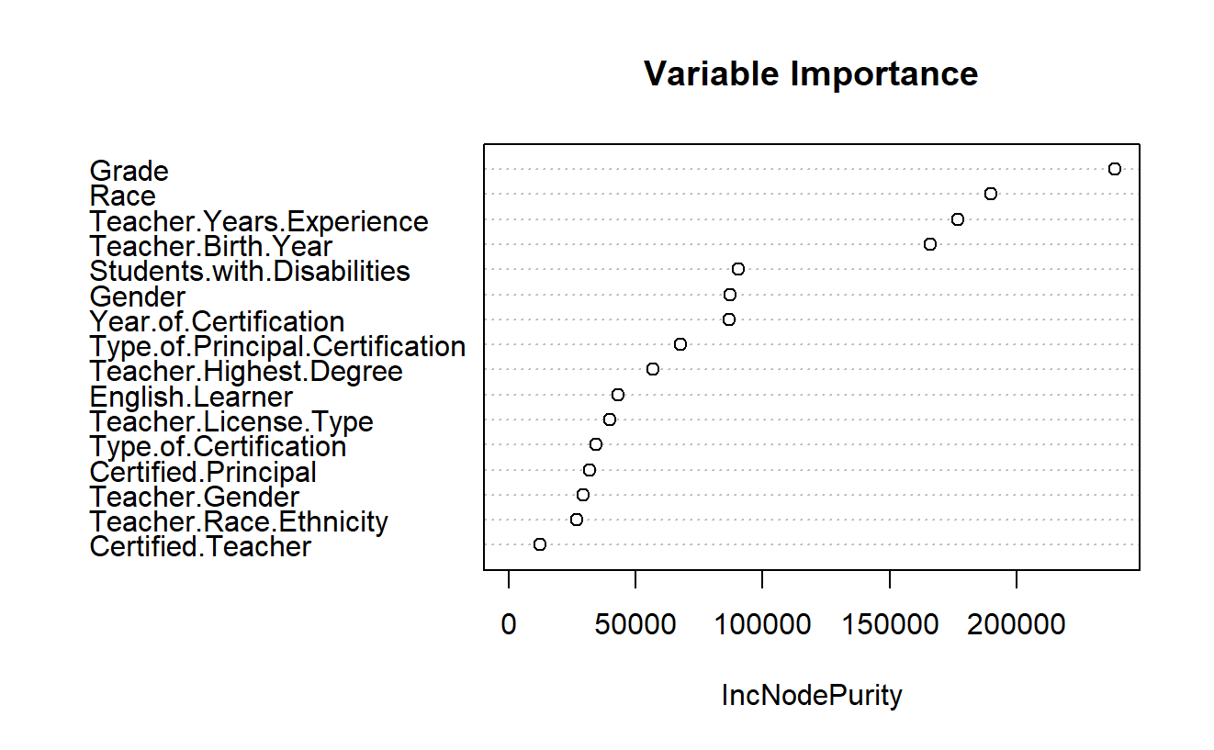
Random Forest on Growth (math dataset)
Does not include test name, generated teacher ID as predictors; removed other possible outcomes (vertical scaled score, etc.)

Slide 12
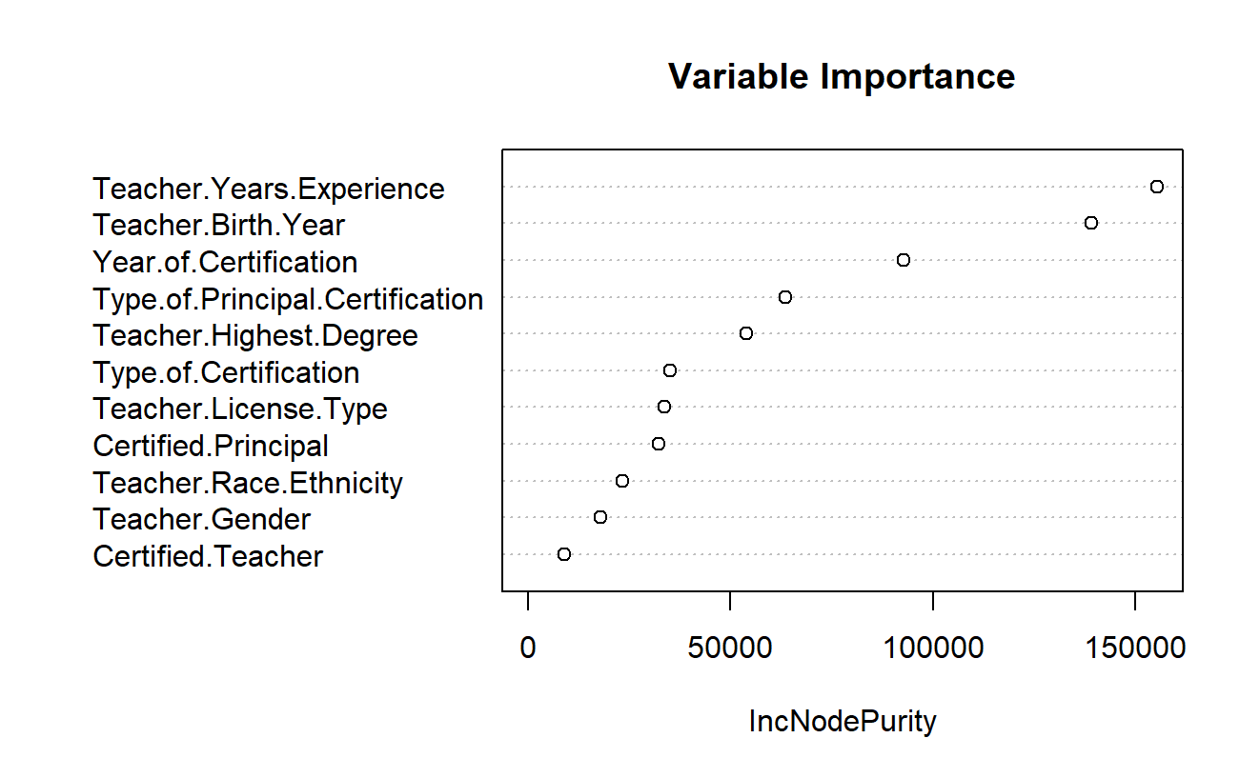
Random Forest on Growth (math dataset)
Does not include student demographic information.

Slide 13
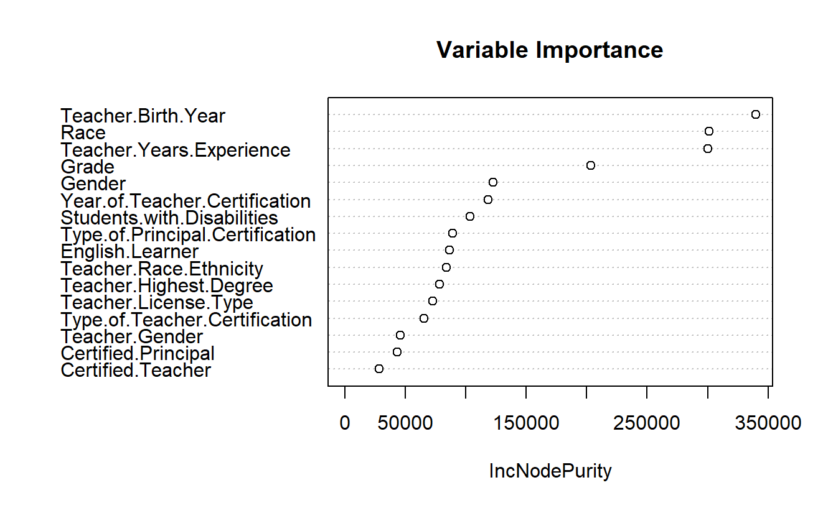
Random Forest on Growth (reading dataset)
Does not include test name, generated teacher ID as predictors; removed other possible outcomes (vertical scaled score, etc.)

Slide 14
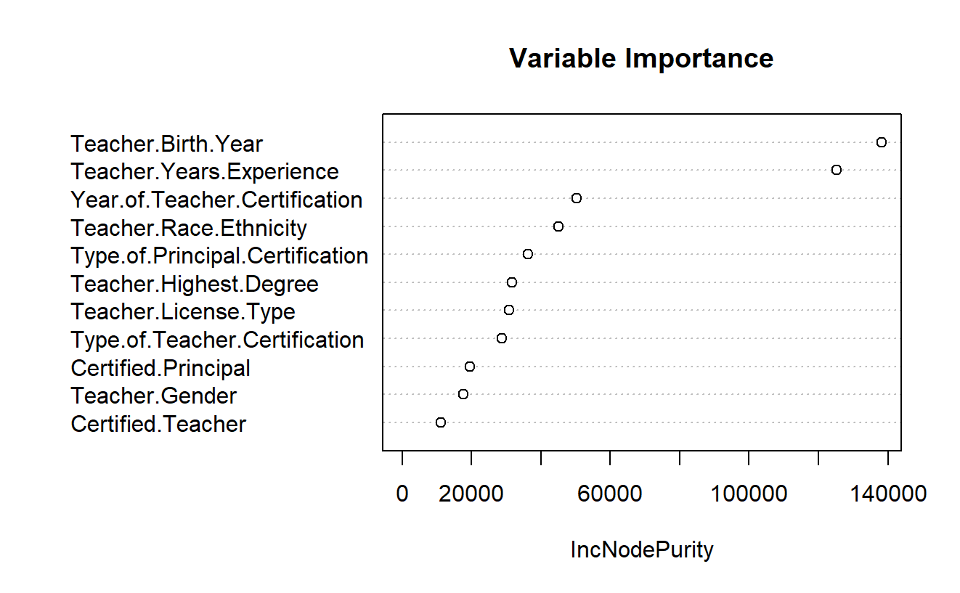
Random Forest on Growth (reading dataset)
Does not include student demographic information.

Slide 15
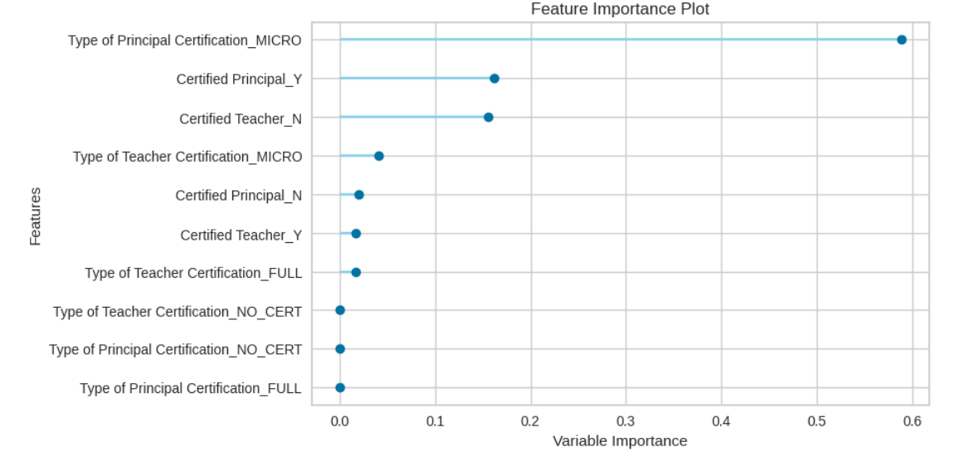
Decision Tree on Read Dataset for Teacher + Principal Certification (y = Growth)

Slide 16
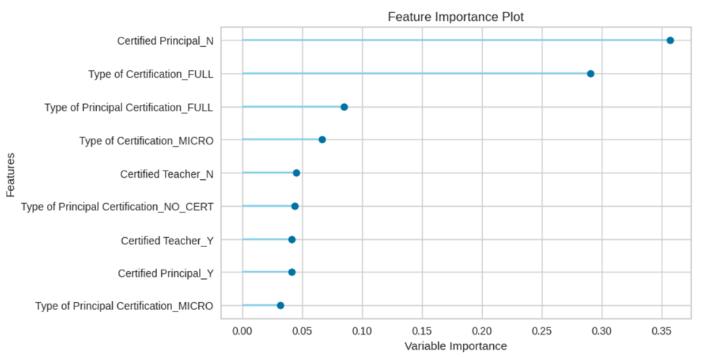
Decision Tree on Math Dataset for Teacher + Principal Certification (y = Growth)

Slide 17
Next Steps
Explore further statistical significance
Examine multicollinearity
Consider interaction terms in the model architecture
Write up final report and presentation

